Slide 1
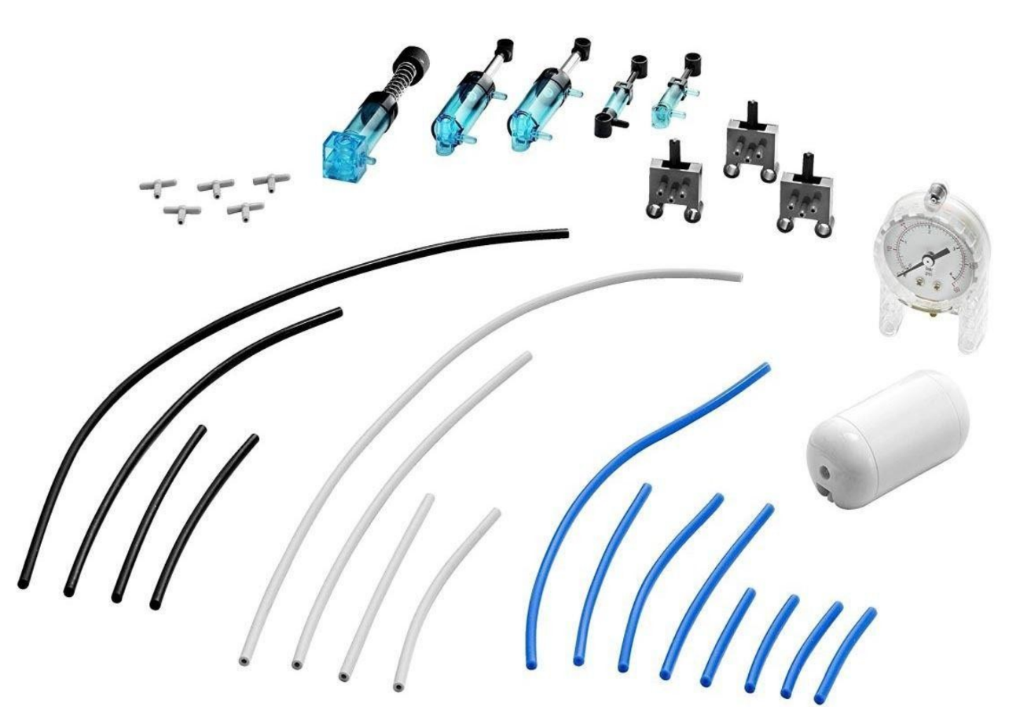
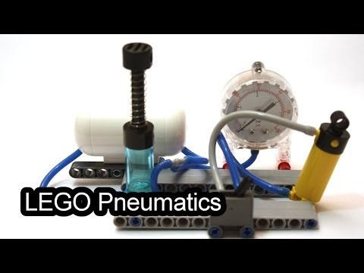
LEGO Pneumatics
Components
Pumps
Actuators
Hoses and connectors
Valves/Switches
Tank & Gauge
Pneumatics Sub-Systems
Follow Video Example
Actuator-to-Actuator
Pump-to-Valve/Actuator (single)
Pump-to-Valve/Actuator (dual)
Add tank to pump side
Add pressure gauge to
pump side with T-connector
Create your own model

